Slide 1
Login

Slide 2
What we have done
Match
Entity User class to match with the database table
Signup form to get user’s data
A database to store User data
Repository to save data to the database
@Autowired
Controller class to handle the data
Save

Slide 3
New things to do
Match
Entity User class to match with the database table
Signup form to get user’s data
Spring security
A database to store User data
Login form
Repository to save data to the database
@Autowired
Controller class to handle pages and data
Get /
Save
Class to represent authenticated user
call
new an object
@Autowired
*Need to update Repository to findByEmail()
Service class loadUserByUserName()
Notes:
Login form is created by Spring security. When a user logs in, spring security will call a method loadUserByUserName() in a service class
The service class needs the help from the Repository class, so it autowire the repository class
Why do not need the controller for the login form page?
Spring security does it for us. You can create a login page to override the default one if you do not like the one provided.

Slide 4
Create a services package and a service class to loadUserByUserName() when a user signs in
public class CustomUserDetailsService implements UserDetailsService {
@Autowired
private UserRepository userRepo;
@Override
public UserDetails loadUserByUsername(String username) throws UsernameNotFoundException {
User user = userRepo.findByEmail(username);
if (user == null) {
throw new UsernameNotFoundException("User not found");
}
return new CustomUserDetails(user);
}
}
UserDetailsService is provided by Spring security
https://docs.spring.io/spring-security/site/docs/3.0.x/apidocs/org/springframework/security/core/userdetails/UserDetailsService.html
Notes:
UserDetailsService is provided by Spring security
import org.springframework.beans.factory.annotation.Autowired;
import org.springframework.security.core.userdetails.UserDetails;
import org.springframework.security.core.userdetails.UserDetailsService;
import org.springframework.security.core.userdetails.UsernameNotFoundException;
public class CustomUserDetailsService implements UserDetailsService {
@Autowired
private UserRepository userRepo;
@Override
public UserDetails loadUserByUsername(String username) throws UsernameNotFoundException {
User user = userRepo.findByEmail(username);
if (user == null) {
throw new UsernameNotFoundException("User not found");
}
return new CustomUserDetails(user);
}
}

Slide 5
Update UserRepository to findByEmail()
public interface UserRepository extends JpaRepository<User, Long> {
@Query("SELECT u FROM User u WHERE u.email = ?1")
public User findByEmail(String email);
}
Notes:
The method does not have a body, only has a title. Will that work?
It is like, go get the data, but repository class dot not need to do anything with the data gotten
Specify positional parameters in your JPQL string using an integer prefixed by a question mark. When there are multiple ?, it specify which parameter it is with a number.
Reference for query
https://www.objectdb.com/java/jpa/query/parameter#ordinal_parameters_index

Slide 6
Create a model package and a class implements UserDetails (defined by Spring Security) to represent an authentication user
Override methods
Add a private User user;
Add a constructor
private User user;
Add a new function
Codes are in the comment section
public CustomUserDetails(User user) {
this.user = user;
}
public String getFullName() {
return user.getFirstName() + " " + user.getLastName();
}
Notes:
The authenticated user is still a user object, but the authenticated user has more functions. So we can create a constructor using User as the parameter.
import java.util.Collection;
import org.springframework.security.core.GrantedAuthority;
import org.springframework.security.core.userdetails.UserDetails;
import com.example.RegistrationClass.entity.User;
public class CustomUserDetails implements UserDetails{
private User user;
public CustomUserDetails(User user) {
this.user = user;
}
@Override
public Collection<? extends GrantedAuthority> getAuthorities() {
// TODO Auto-generated method stub
return null;
}
@Override
public String getPassword() {
// TODO Auto-generated method stub
return user.getPassword();
}
@Override
public String getUsername() {
// TODO Auto-generated method stub
return user.getEmail();
}
@Override
public boolean isAccountNonExpired() {
// TODO Auto-generated method stub
return true;
}
@Override
public boolean isAccountNonLocked() {
// TODO Auto-generated method stub
return true;
}
@Override
public boolean isCredentialsNonExpired() {
// TODO Auto-generated method stub
return true;
}
@Override
public boolean isEnabled() {
// TODO Auto-generated method stub
return true;
}
public String getFullName() {
return user.getFirstName() + " " + user.getLastName();
}
}

Slide 7
UserDetailsService
The UserDetailsService is a core interface in Spring Security framework, which is used to retrieve the user’s authentication and authorization information.
It has a single read-only method named as loadUserByUsername() which locate the user based on the username.
https://www.boraji.com/spring-security-5-custom-userdetailsservice-example

Slide 8
Model vs. Entity
Entity: An entity represents a single instance of your domain object saved into the database as a record. It has some attributes that we represent as columns in our tables.
Model: A model typically represents a real-world object. In programming, we create classes to represent objects. These classes, known as models, have some properties and methods (defining objects behavior).
The model class is a POJO (Plain Old Java Object)-just an old java object
Notes:
https://stackoverflow.com/questions/8743995/what-is-difference-between-a-model-and-an-entity
Entity-database
Model- related to presenting data to the pages MVC
Those are your project packages, so technically you can call them whatever you want, but I guess it is a good idea to follow the conventional way, so that your projects will be easier to read for other people.
Java class with attributes---getter and setter

Slide 9
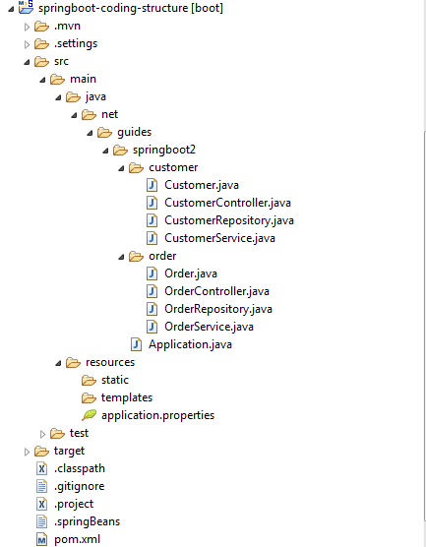
Project structure-first style
Notes:
https://medium.com/the-resonant-web/spring-boot-2-0-project-structure-and-best-practices-part-2-7137bdcba7d3
Typically there are two styles

Slide 10
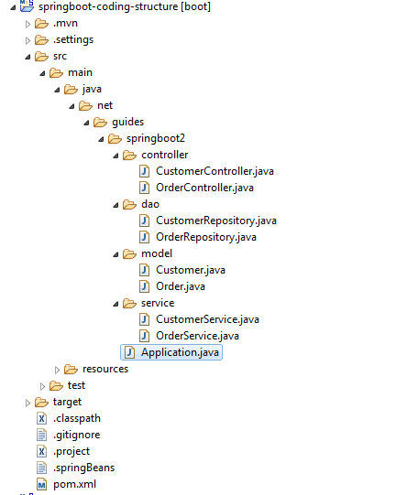
Project structure-second style

Slide 11
Configure Spring Security for Authentication
Create a config package, then a WebSecurityConfig class
Codes are in the comment section
Notes:
import javax.sql.DataSource;
import org.springframework.beans.factory.annotation.Autowired;
import org.springframework.context.annotation.Bean;
import org.springframework.context.annotation.Configuration;
import org.springframework.security.authentication.dao.DaoAuthenticationProvider;
import org.springframework.security.config.annotation.authentication.builders.AuthenticationManagerBuilder;
import org.springframework.security.config.annotation.web.builders.HttpSecurity;
import org.springframework.security.config.annotation.web.configuration.EnableWebSecurity;
import org.springframework.security.config.annotation.web.configuration.WebSecurityConfigurerAdapter;
import org.springframework.security.core.userdetails.UserDetailsService;
import org.springframework.security.crypto.bcrypt.BCryptPasswordEncoder;
import com.example.RegistrationClass.service.CustomUserDetailsService;
@Configuration
@EnableWebSecurity
public class WebSecurityConfig extends WebSecurityConfigurerAdapter {
//@Autowired
//private DataSource dataSource;
@Bean
public UserDetailsService userDetailsService() {
return new CustomUserDetailsService();
}
@Bean
public BCryptPasswordEncoder passwordEncoder() {
return new BCryptPasswordEncoder();
}
@Bean
public DaoAuthenticationProvider authenticationProvider() {
DaoAuthenticationProvider authProvider = new DaoAuthenticationProvider();
authProvider.setUserDetailsService(userDetailsService());
authProvider.setPasswordEncoder(passwordEncoder());
return authProvider;
}
@Override
protected void configure(AuthenticationManagerBuilder auth) throws Exception {
auth.authenticationProvider(authenticationProvider());
}
@Override
protected void configure(HttpSecurity http) throws Exception {
http.authorizeRequests()
.antMatchers("/users").authenticated()
.anyRequest().permitAll()
.and()
.formLogin()
.usernameParameter("email")
.defaultSuccessUrl("/users")
.permitAll()
.and()
.logout().logoutSuccessUrl("/");
}
}

Slide 12
@Override
protected void configure(HttpSecurity http) throws Exception {
http.authorizeRequests()
.antMatchers("/users").authenticated()
.anyRequest().permitAll()
.and()
.formLogin()
.usernameParameter("email")
.defaultSuccessUrl("/users")
.permitAll()
.and()
.logout().logoutSuccessUrl("/").permitAll();
}
}
Reference https://docs.spring.io/spring-security/site/docs/4.1.1.RELEASE/reference/htmlsingle/
Notes:
authorizeRequests() Allows restricting access based upon the HttpServletRequest using RequestMatcher implementations
Here in the configure() method, a user must login to see the list users page (URL /users) and other pages do not require authentication. We also configure the default login page (generated by Spring Security) with the parameter name of the username field is email and the default success URL is /users – that means after successful login, the user will be redirected to the list users page.
They are executed in order

Slide 13
Update the AppController class
@GetMapping("/users")
public String listUsers(Model model) {
List<User> listUsers = userRepo.findAll();//it is going to find all users
model.addAttribute("listUsers", listUsers);
return "users";
}
import java.util.List;

Slide 14
Update the AppController class
@PostMapping("/process_register")
public String processRegister(User user) {
//how come userRepo can save data without any methods in it?
BCryptPasswordEncoder passwordEncoder = new BCryptPasswordEncoder();
String encodedPassword = passwordEncoder.encode(user.getPassword());
user.setPassword(encodedPassword);
userRepo.save(user);
return "register_success";
}

Slide 15
Thymeleaf
<div th:if="${param.error}">
<p class="text-danger">[[${session.SPRING_SECURITY_LAST_EXCEPTION.message}]]</p>
</div>
<p>Hello, [[${session.user.name}]]!</p>
<p>Hello, <span th:text="${session.user.name}">Sebastian</span>!</p>
https://www.thymeleaf.org/doc/tutorials/2.1/usingthymeleaf.html#inlining
Notes:
HTTP param
When a user name or password is incorrect, SPRING_SECURITY_LAST_EXCEPTION.message displays 'Bad credentials';

Slide 16
<form th:action="@{/logout}" method="post">
<p>
Welcome <b>[[${#request.userPrincipal.principal.fullName}]]</b>
</p>
<input type="submit" value="Sign Out" />
</form>
@Override
protected void configure(HttpSecurity http) throws Exception {
http.authorizeRequests()
.antMatchers("/users").authenticated()
.anyRequest().permitAll()
.and()
.formLogin()
.usernameParameter("email")
.defaultSuccessUrl("/users")
.permitAll()
.and()
.logout().logoutSuccessUrl("/").permitAll();
}
}
Notes:
In configuration, it says logout() will go to the default page
In the html form, there is url /logout. I will be handled by spring security, has to be “/logout”
The principal is the currently logged in user
.fullName is matched with the getFullName() method
If you change the above to .fffllName, and getFffullName, they still work. As long as the names match
Thymeleaf can call the getFullName method try
>[[${#request.userPrincipal.principal.getFullName()}]]

Slide 17
What are @Beans?
In Spring, the objects that form the backbone of your application and that are managed by the Spring IoC container are called beans. A bean is an object that is instantiated, assembled, and otherwise managed by a Spring IoC container.
https://www.baeldung.com/spring-bean

Slide 18
An example
public class Address {
private String street;
private int number;
public Address(String street, int number) {
this.street = street;
this.number = number;
}
// getters and setters
}
public class Company {
private Address address;
public Company(Address address) {
this.address = address;
}
// getter, setter and other properties
}

Slide 19
Traditional Approach of creating a company object
Address address = new Address("High Street", 1000);
Company company = new Company(address);
The address object is actually not necessary----we only need the address, but to get it, an address object is created
Notes:
The address object is actually not necessary----we only need the address, but to get it, an address object is created

Slide 20
Inversion of Control (IoC)
Instead of constructing dependencies by itself, an object can retrieve its dependencies from an IoC container.
All we need to do is to provide the container with appropriate configuration metadata.
@Configuration @ComponentScan(basePackageClasses = Company.class)
public class Config {
@Bean
public Address getAddress() {
return new Address("High Street", 1000);
}
}
public class Company {
private Address address;
public Company(Address address) {
this.address = address;
}
// getter, setter and other properties
}

Slide 21
Inversion of Control (IoC)
Inversion of Control (IoC) is a process in which an object defines its dependencies without creating them. This object delegates the job of constructing such dependencies to an IoC container.
Notes:
https://www.baeldung.com/spring-bean

